Slide 1

University Institute of Engineering
DEPARTMENT OF COMPUTER SCIENCE & ENGINEERING
Bachelor of Engineering (Computer Science & Engineering)
Subject Name : SEARCH ENGINE OPTIMIZATION
Subject Code: 20CST-463
Topic: Lecture-1.2.1
Lecture- On-Page Optimization
By : Sourabh Budhiraja
DISCOVER . LEARN . EMPOWER

Slide 2
Syllabus
UNIT-1: Introduction to Search Engine Optimization
CHAPTER-1: Introduction to Search Engine Optimization:
Understanding of search engines, Basics of SEO, Keyword Research, On-Page Optimization, Technical SEO.
CHAPTER-2: Content Creation and SEO tools:
Content Creation for SEO, SEO Analytics, SEO Tools, Local SEO, SEO Ethics and Future Trends.

Slide 3
CONTENTS
What is On-Page Optimization?
Important On-Page SEO factors
Summary

Slide 4
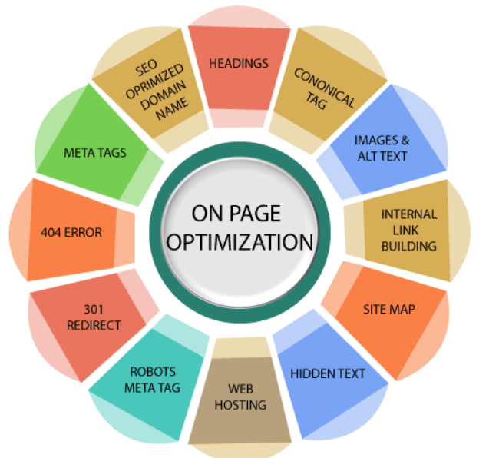
What is On-Page Optimization?
On page optimization refers to all measures taken by SEOs within the website to improve the ranking of a site in search engine result pages. These measures are related to content and HTML source code of a page, e.g., meta tags, keyword placement, and keyword density including the technical set-up, the content, and user-friendliness of your site. So, on page seo optimization factors are linked with the elements of your website.
Fig. 1.2.1

Slide 5
Important On-Page SEO factors
1. Keyword in the Title tag: Title tag tells the search engine and users about your content. It provides an accurate description of the content, which makes it an important relevancy signal for a search engine. So, one can incorporate relevant keywords in the title tag that represents your content and thus can assist search engines and users in understanding what they are going to read and accordingly to improve its ranking.
2. Keyword in meta description tag: It is a summary or snippet of your page, which is displayed on search engine result pages below the URL. You may include your keywords in this and make it make more relevant, appealing, and informative to search engines and users and thus can get more click on your link.
3. Keyword in the H1 tag: It is also a relevance factor that introduces your page or acts as a description of your page. So, you may also include your main keywords in the H1 tag to improve its ranking.

Slide 6
Important On-Page SEO factors(Cont.)
4. The length of the page: Today, the users don't get satisfied with basic information; instead, they want to be educated by reading all the possible information about a topic. The search engine, therefore, prefers lengthy pages to rank first as the longer pages can cover more aspects of your topic.
5. Canonical Tag: You should use the canonical tag when you have two URLs with similar content. This tag prevents the issue of duplicate content as it tells Google that one URL is equivalent to another, so the two pages with the same content are not different pages and they belong to the original page.
6. Image Optimization: Along with the text, images should also be optimized by using alt text, caption and description, and more. Furthermore, don't name your image as 'image1.jpg' instead use descriptive filenames, for example, 'woman-driving-car.jpg.'

Slide 7
Important On-Page SEO factors(Cont.)
7. Content Updates: Search engines prefers freshly updated content. So, keep adding more information to the site and update the old pages if required.
8. Outbound Links: You can use outbound links to send users to another website if you want to provide more information. So, it can be a trust factor for Google. However, using too many outbound links many affect the rankings, so use them in moderation.
9. Internal Links: You can interlink your pages so that traffic from a one may be diverted to other pages which are less clicked by the users.

Slide 8
Important On-Page SEO factors(Cont.)
10. Keyword in URL: The URL should contain the keywords as it is also a way to send a relevancy signal to search engines.
11. Sitemap: You can create a Sitemap for your site. It helps search engines to index all pages on your website, which is a part of SEO.
12. Google Search Console Integration: You can verify your site at Google Webmaster Tool. It provides you valuable data to optimize your size.

Slide 9
Important On-Page SEO factors(Cont.)
13. Content of Page: The content of the page should be of good quality, relevant, and latest. Furthermore, it should supply the largest demand, which means it should be related to highly searched topics, keywords, etc.
14. Linkable Content: This type of content is crafted with the objective of attracting links generally from other websites in your niche.
15. Content Formatting: The content should be readable and organized, which you can achieve through different ways, such as:

Slide 10
Important On-Page SEO factors(Cont.)
The content should be readable and organized, which you can achieve through different ways, such as:
Highlight the important parts of a page using bold, underline and italics options.
Use a suitable font size at least 14 px.
Split the content into small paragraphs of 4-5 lines.
Maintain the required spacing between the paragraphs to make the post easy to read.
Use CSS to create sections that break the content into manageable parts and make it appealing.

Slide 11
Important On-Page SEO factors(Cont.)
16. Images and Multimedia Elements: The images make your content more appealing and presentable, so add images to your content if possible. However, do not add images unnecessarily or too many as it may leave a bad impression. The images should not be very large as it may increase the loading time of your page, which is not good for SEO.
17. URL Optimization: You can optimize a URL in two different ways: URL optimization and URL structure.
The URL of a page, which is also known as a slug, is a permanent link. An optimized URL should be less than 255 characters, and hyphens '-'should be used to separate the different parts of the URL. Furthermore, it should be short, descriptive, and include your target keywords.

Slide 12
Important On-Page SEO factors(Cont.)
Some examples of SEO optimized URLs:
www.javatpoint.com/seo-tutorial-for-beginners https://www.javatpoint.com/seo-on-page-optimization
18) URL Structure Optimization: The URL structure should reflect the actual structure of a website. You can optimize it by making categories that help users and search engines find the content with ease. A website without categories is like a warehouse with unorganized items, and with categories, it looks like a warehouse where items divided into different categories. Although you can have sub-categories, it is advised not to go over two levels: For example:
Homepage>Social Media> Twitter> Article (optimized) Homepage>Social Media> Twitter> How to>Article (not optimized)

Slide 13
Important On-Page SEO factors(Cont.)
19) Internal links: Interlinking the web pages of a website is very important for SEO. It allows you to create your own web or network. A search engine spider follows the links found on a page, both internal and external links. If a page lacks links, the spider will read your page and go. It also helps keep users on your site for a long time.
20) External Links: External links can be used for SEO as they allow you to link your site to other high-quality related websites, which makes your site more trustworthy, which is good for SEO.

Slide 14
Important On-Page SEO factors(Cont.)
21) Page Loading Speed: Search engines always keep putting efforts to make the web faster. It prefers to include the fastest websites in its index, which is good for a site in terms of SEO. It also helps with customer retention and conversions.
22) Mobile Friendliness: With the increase in mobile internet users, around 60% searches in Google are generated through mobile devices. So, a website, which is not mobile-friendly, maybe losing half of the potential traffic.

Slide 15
Summary
To get an idea of the popular keywords on a particular niche, keyword analysis tools like Semrush, longtailpro, etc. are used.
While these are the tools a user may have to pay for, there is a free tool by Google that lets you shortlist keywords in minimal time. The Google crawlers look for the following things while landing on a website:
URL
Title tags
Meta tags
Category tags
Internal linkings in a website
External linking to other websites

Slide 16
Summary(Cont.)
To implement On-page SEO to your site, following things can be applied:
Adding Yoast SEO plugin to your WordPress site. This plugin helps in making the site SEO friendly, which can be installed on any self-hosted WordPress website.
Take popular keywords from the keyword planner tool and try to apply on your website. Example: You came across a keyword “SEO checker tools”, you may add this to the title to make it like “A guide to SEO checker tools” or even add this keyword at few places while developing the body of the content.
Using keywords in tags and meta descriptions.
Adding alt text to the images.

Slide 17
References
Books and Journals
Eric Enge, Stephan Spencer, Rand Fishkin, Jessie C Stricchiola, “The Art of SEO : Mastering Search Engine Optimization”, O'Reilly Media, October,2009.
https://www.hubspot.com/hs-fs/hub/53/file-13221845-pdf/docs/ebooks/introduction-to-seo-ebook.pdf
Fhttps://www.startupgeeks.it/wp-content/uploads/2018/12/ebook-seo-sej-complete-guide-2018.pdf
Video Link-
https://youtu.be/xsVTqzratPs
https://youtu.be/t12u9vD-ip0?list=PLc20sA5NNOvqY8K-gtLCljTDTP6-SMruP
Web Link-
https://www.geeksforgeeks.org/search-engine-optimization-seo-basics/
https://www.tutorialspoint.com/seo/index.htm

